Slide 1
Writing a Literary Analysis
BRIAN YOTHERS
Brought to you in cooperation with the Purdue Online Writing Lab
Notes:
Rationale: Welcome to “Writing the Literary Analysis.” This 14-slide presentation is designed to help teachers introduce writing literary analyses to their students.
Directions: Each slide is activated by a single mouse click, unless otherwise noted in bold at the bottom of each notes page.
Writer and Designer: Brian Yothers
Updating authors: Arielle McKee, 2014
Developed with resources courtesy of the Purdue University Writing Lab
Grant funding courtesy of the Multimedia Instructional Development Center at Purdue University
© Copyright Purdue University, 2007.
‹#›

Slide 2
What is Literary Analysis?
It’s literary.
It’s an analysis.
It’s—
An Argument!
It may also involve research on and analysis of secondary sources.

Slide 3
Important Literary Concepts
The Basics:
Plot
Setting
Narration/point of view
Characterization
Symbol
Metaphor
Genre
Irony/ambiguity
Other Key Concepts:
Historical context
Social, political, economic contexts
Ideology
Multiple voices
Various critical orientations
Literary theory

Slide 4
How is it “Literary”?
Usually, a literary analysis will involve a discussion of a text as writing, thus the term literary, which means “having to do with letters.”
This will involve the use of certain concepts that are very specifically associated with literature.
Metaphor?
Setting?

Slide 5
What is an Analysis?
An analysis of a literary work may discuss:
How the various components of an individual work relate to each other.
How two separate literary works deal with similar concepts or forms.
How concepts and forms in literary works relate to larger aesthetic, political, social, economic, or religious contexts.

Slide 6
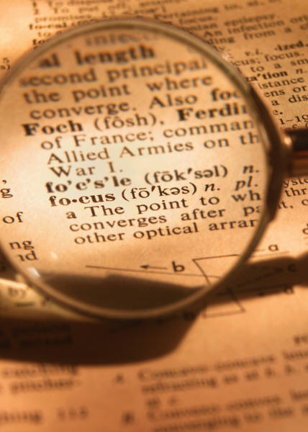
How is Literary Analysis
An Argument?
Writing an Argument:
When writing a literary analysis, you will focus on specific attribute(s) of the text(s).
When discussing these attributes, you will want to make sure that you are making a specific, arguable point (thesis) about these attributes.
You will defend this point with reasons and evidence drawn from the text.

Slide 7
Mrs. Michael’s
Overview
Introductions
1. Opening: attention getter
|
2. Background
& Topic
Discussion
|
V
3. specific (thesis)

Slide 8
Mrs. Michael’s
Overview
Introduction to a
Literary Analysis
Opening: Attention Getter
Interesting fact (needs parenthetical citations)
Powerful image
Related anecdote
Universal message avoid: rhetorical questions;
definitions; “powerful” quotations
Background or Discussion
Literary Topic: the novel, author, basic plot, or
central/key ideas
Thesis Statement

Slide 9
Thesis Statements
Which is the best Thesis Statement?
Moby-Dick is about the problem of evil.
Moby-Dick is boring and pointless.
Moby-Dick is about a big, white whale.
The use of “whiteness” in Moby-Dick illustrates the uncertainty of the meaning of life that Ishmael expresses throughout the novel.

Slide 10
Mrs. Michael’s
Overview
Thesis Statements

Slide 11
Mrs. Michael’s
Overview
Thesis Statements
Topic + Verb + Argument/Point to be shown
Topic = novel & literary focus
Verb = variation of “shows”
Argument = message or effect that results from literary technique

Slide 12
Mrs. Michael’s
Overview
Body Paragraph Structure
Claim
Topic Sentence
Transition & 1st Point, 2nd Point, 3rd Point, etc.
Evidence
Quoted or Paraphrased Facts, Opinions, or Information
Purpose of this is to support the point that is being explained, defended, or refuted
Parenthetical Citations are included
Warrant
This explains what the evidence says or is showing
Then it connects the point to the topic being explained, defended, or refuted in the paragraph

Slide 13
Mrs. Michael’s
Overview
Body Paragraph Structure
Detailed Body Paragraph Structure
Topic Sentence (Claim)
1st Point (Sub-Claim)
Evidence & Citation
Specific Explanation (Warrant)
Overall Connection (Warrant)
2nd Point (Sub-Claim)
Evidence & Citation
Specific Explanation (Warrant)
Overall Connection (Warrant)
Clincher (Claim & Thesis)

Slide 14
How to Support
A Thesis Statement
Evidence and Support:
Include examples from the text:
Direct quotations
Summaries of scenes
Paraphrases
Cite other critics’ opinions
Discuss the text’s historical and social context
Always remember to read carefully and highlight useful passages and quotes.

Slide 15
What is a
Secondary Source?
Secondary Sources:
A book or article that discusses the text you are discussing.
A book or article that discusses a theory related to the argument you are making.
A book or article that discusses the social and historical context of the text you are discussing.
For example: In discussing Chaucer’s Pardoner’s Tale,
Lee Patterson argues that: “…

Slide 16
How do I Find
Secondary Sources?
You might consult:
Academic Databases
EX: The MLA International Bibliography
The Dictionary of Literary Biography
Discipline-specific sources:
EX: America: History and Life for American Literature
Other search engines
A bibliography that is part of your text
Your instructor

Slide 17
Integrating
Secondary Source
When you use secondary sources, be sure to show how they relate to your thesis.
Don’t overuse any one secondary source, or for that matter, secondary sources in general
Remember that this is your paper, your argument—the secondary sources are just helping you out.
Never, never, never plagiarize. See the OWL handout on plagiarism for more information.

Slide 18
Recap: Literary Analysis
When writing a literary analysis:
Be familiar with literary terms.
Analyze specific items.
Make an a argument.
Make appropriate use of secondary sources.
Consult instructors and tutors for help when needed.

Slide 19
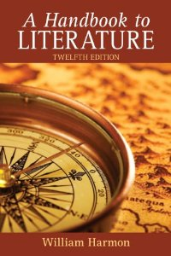
How Can I Learn More?
Check your library for:
Various handbooks of literary terms
Numerous introductions to literary criticism and theory, widely available.
Example: A Handbook to Literature, Harmon/Holman

Slide 20
Where to Go
for More Help
Purdue University Writing Lab, Heavilon 226
Check our web site: http://owl.english.purdue.edu
Email brief questions to OWL Mail:
https://owl.english.purdue.edu/contact/owlmailtutors

Slide 21
The End
WRITING A LITERARY ANALYSIS
BRIAN YOTHERS
Brought to you in cooperation with the Purdue Online Writing Lab

